Slide 1
Progress Report 1/26 – 2/2
Presenter: Roger Hsiao

Slide 2
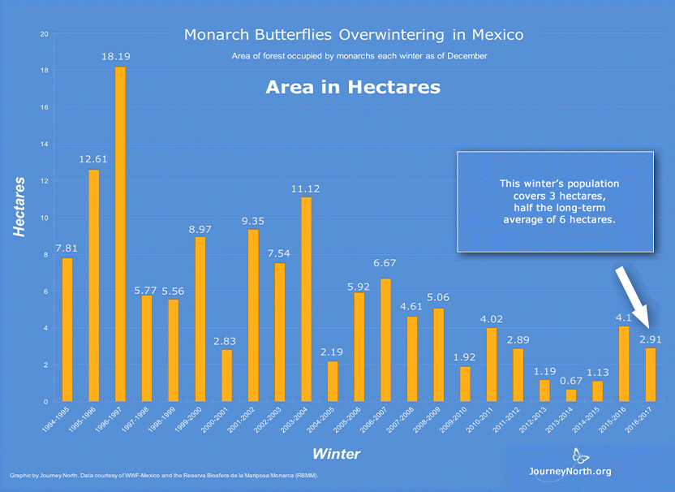
Task 1: Find out how many sensors are needed to cover the specified area.
Given:
Area
2.91 hectares
Sensor detection range
20, 30, or 60 m

Slide 3
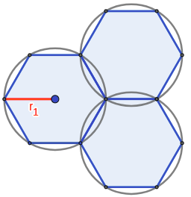
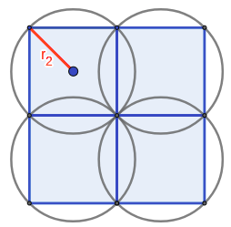
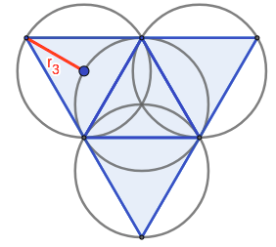
Possible Configurations
Hexagon Square Triangle

Slide 4
Comparison Between Configurations
Configuration: | Hexagon | Square | Triangle
Effective area
Overlap | 17.3% | 36.3% | 100%

Slide 5
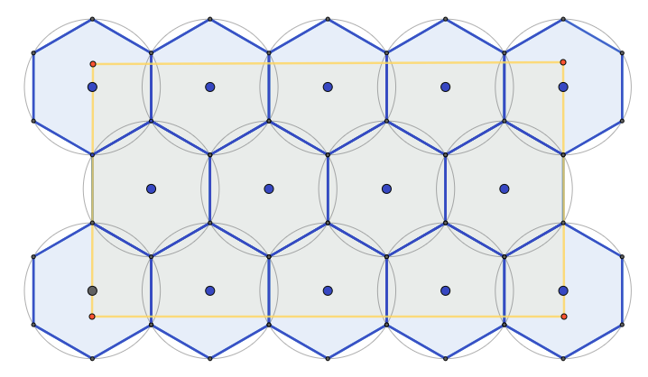
Hexagon Configuration

Slide 6
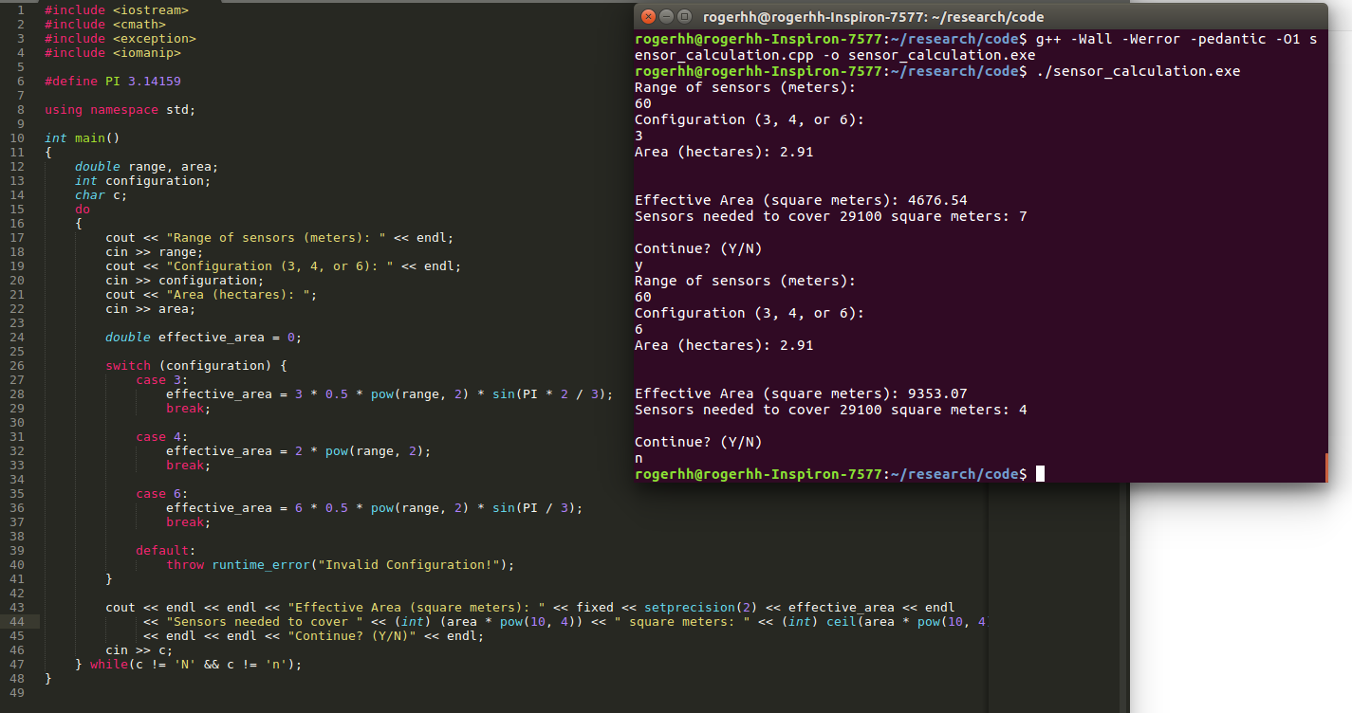
Automated Calculation

Slide 7
Comparison Between Different Sensor Ranges
Sensor range: | 20 m | 30 m | 60 m
Effective coverage | 1039.23 m² | 2338.27 m² | 9353.07 m²
Sensors needed to cover 2.91 hectares | 29 | 13 | 4

Slide 8
Task 2: Find out how many sensors are needed to cover the specified area.
Given:
Area
2.91 hectares
Sensor detection range
20, 30, or 60 m

